Slide 1
Day 8
The Secrets of a Phenomenal Relationship (THE SPARK OF LIFE)

Slide 2
Skill 5 :Harness Courage and Embrace honesty

Slide 3
DAY 8 – RECLAIMING YOUR PASSION: UNDERSTAND, APPRECIATE AND RELATE TO THE ONE YOU LOVE
HOW YOU CAN CHOOSE LOVE EVERY TIME
HOW TO LET GO OF THE PAST

Slide 4
YOU WILL LEARN IN THIS SESSION
TO RELEASE THE PAST, YOU MUST FOCUS ON YOUR PRESENT AND FUTURE
TRANSFORM YOUR WORDS

Slide 5
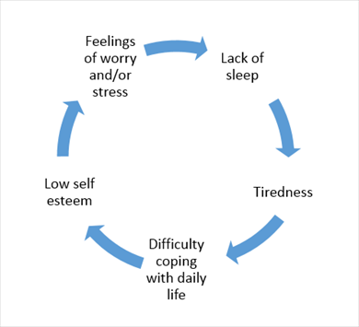
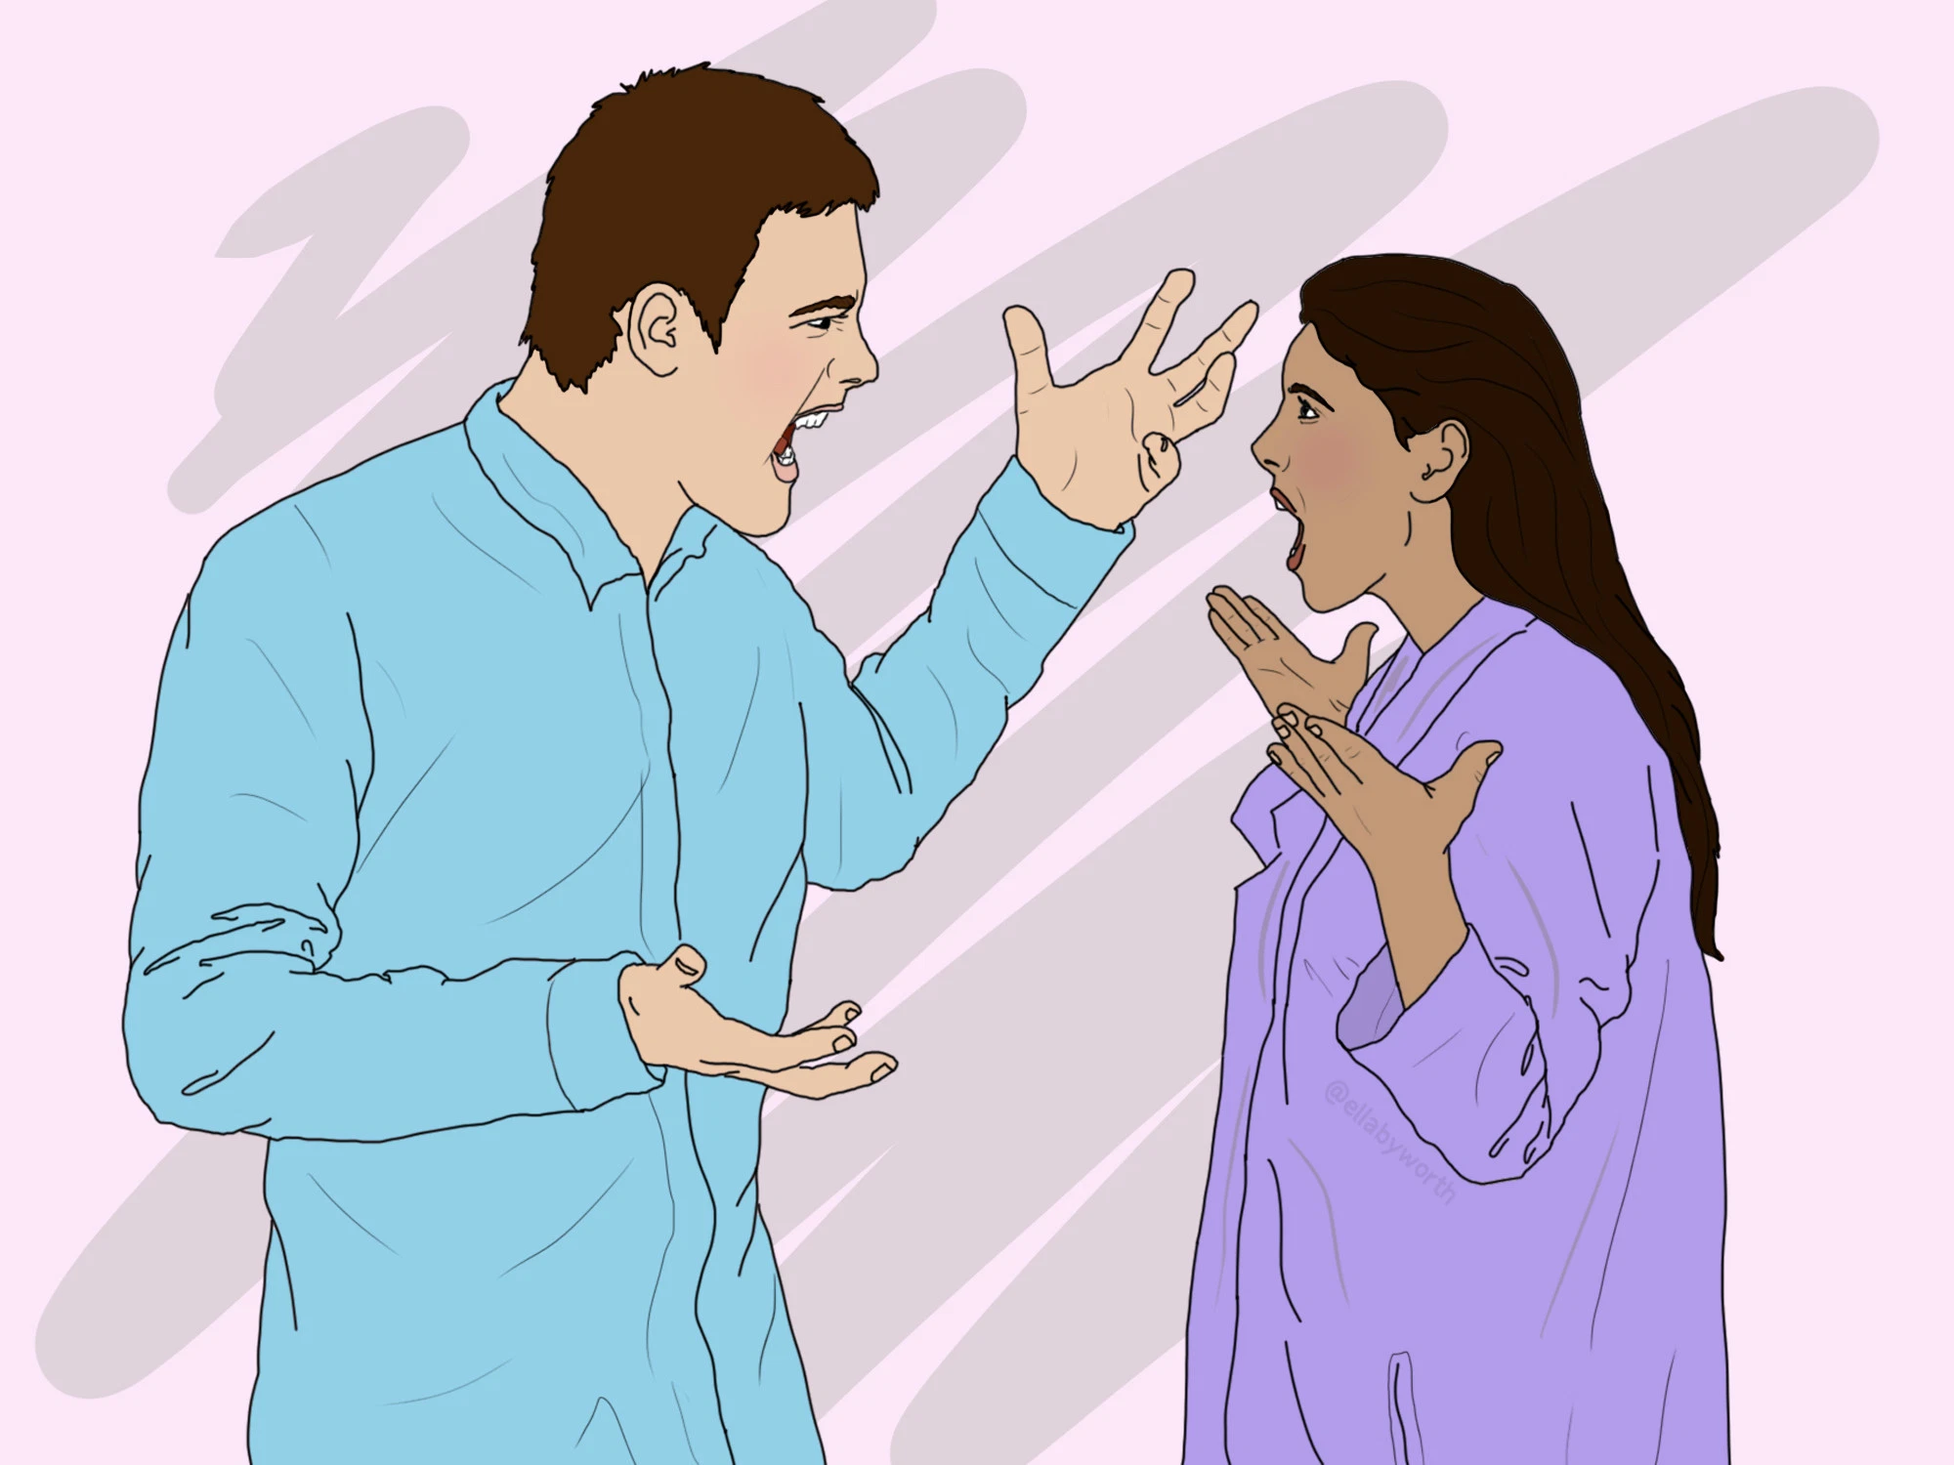

Slide 6
How to Break Negative Cycle in Relationships?
Write down everything that troubles you in your relationship.
Break the pattern
TRANSFORM YOUR WORDS

Slide 7
Not bad but some unpleasant moments
There are many possible negative things that can happen to us in a day—from the little things like coffee spilling, being caught in a traffic jam, losing our keys, having people criticize you, to the bigger mishaps like getting into a car accident, losing our valuables, breaking up from relationships, or losing our jobs.

Slide 8
Whenever something bad happens to us, it’s easy for us to slip into one of the following behaviors:
Self-victimization. We ask ourselves “Why is this happening to me? Why am I so unlucky? Why doesn’t this happen to anyone else? It’s not fair!”

Slide 9
Whenever something bad happens to us, it’s easy for us to slip into one of the following behaviors:
Reacting in anger. We lash back at the situation, or even people around us, for what’s happening.
Self-blame. We make self-depreciating comments like “Why am I so stupid to have done that?” “Only someone like myself can make such a dumb mistake.”

Slide 10
Whenever something bad happens to us, it’s easy for us to slip into one of the following behaviours:
Slipping into depression. For those of us who have faced cases of depression before, we might fall back if we’re not careful at managing our emotions.
Dejection or giving up. We lose hope, or worse still, we give up. We decide it’s not worth it, that life is out to get us, and we should just stop trying altogether.

Slide 11
In relationship
Is this the end of something wonderful or the beginning of something unpleasant?
Are you being punished for your failure or rewarded for your success?

Slide 12
In relationship
In relationships – and in life – your state changes everything.
Your state is the state of your relationship. When two people are in a peak state,
it’s easy to create a relationship that’s also in a peak state. Peak State

Slide 13
In relationship
+ Peak State = Peak Relationship
When one person is in a peak state and their partner is low, often the person in the peak state wants their partner to be happy.
Their partner wishes to stay where they are, which can create tension. Peak State + Low State = Anger, Lowered States and Disagreements

Slide 14
IDENTIFY 3 NEGATIVE WORDS
“I’m frustrated,” “I’m depressed,” or “I’m humiliated.” Come up with alternative words that will lower the intensity of those negative emotions. Maybe instead of “depressed” you say you are “a little bit down.”

Slide 15
TRANSFORM YOUR WORDS
So here are the four steps to your 10-day challenge:
Step 1: Check yourself. Become conscious of the habitual words you use to describe your unhappy or distressing feelings. ...
Step 2: Identify 3 negative words. ...
Step 3: Find 3 positive words. ...
Step 4: Pick two “accountability” buddies.

Slide 16
TRANSFORM YOUR WORDS
sad
angry
anxious
jealous
regretful
bored
Tired
Stressed

Slide 17
Some of Words of Affirmation Masculine Personality Wants to Hear
When you listened to me, you made me feel loved.
You are my man!
You are my protector.
You are awesome!
Hey, do you have any plans later?
I respect you so much.

Slide 18
Some of Words of Affirmation Masculine Personality Wants to Hear
You make me feel like a Lady.
I love being with you.
You’re so smart.
You’re amazing!
Thank you, that was really kind.
You’re so strong.

Slide 19
Some of Words of Affirmation Masculine Personality Wants to Hear
You’re a hard worker.
You know how to make me happy!
When you hold me tight, I feel safe with you.
I like you.
I love your sense of humor.
Thanks for the date . . . I enjoyed being with you.

Slide 20
Some of Words of Affirmation Masculine Personality Wants to Hear
Thank you for thinking of me.
You’re so considerate.
You’re a great lover.
I’ll always stand by your side.
Your secrets are safe with me.
I’m yours.
I’ll go wherever you lead.
I’m blessed you are my husband.

Slide 21
Some of Words of Affirmation Masculine Personality Wants to Hear
I have confidence in your leadership.
I totally trust you.
I’m proud to be your wife.
God has my best in mind. That’s why he gave you to me.
There’s no one like you.
You inspire me to be the best I can be.
The hard times don’t matter – I’m with you.

Slide 22
Words of Affirmation Every feminine Personality Wants to Hear
You are my dream girl.
You are a beautiful person, inside and out.
You’ve got what it takes to make things happen.
You impress me, you really do!
You are a woman of integrity.
I admire you.
I’m proud of how you handled situations like that.
.

Slide 23
Words of Affirmation Every feminine Personality Wants to Hear
You are God’s perfect choice for me
You’re one in a million . . . and you’re mine!
I’m a rich man because you are my wife.
I’d be happy with you anywhere!
You make it all worth while. I wouldn’t want it any other way.
I’ll love you forever.
You make me look good!
When you walked into the room, you took my breath away.
You are an excellent wife and I’m a blessed man.

Slide 24
Words of Affirmation Every feminine Personality Wants to Hear
You bring me joy.
I love the home that you’ve created.
You work hard to make things wonderful
You are God’s perfect choice for me.
You’ll always have my heart.
I’ll always be faithful to you.

Slide 25
Words of Affirmation Every feminine Personality Wants to Hear
Thank you for standing by me.
I really appreciate your loyalty.
You are a great cook/chef.
You’re so creative.
You are a godly woman.

Slide 26
Words of Affirmation Every feminine Personality Wants to Hear
I’ve learned a lot from you.
I’ve seen you grow so much.
I like spending time with you.
You’re as beautiful to me as the day we married.
My favourite place to be is with you.

Slide 27
TRANSFORM YOUR WORDS
frustrated and angry, change I’m a little annoyed
If you say something like, “I’m so worried about this,” stop yourself and acknowledge that “worry” might be too strong a word. Maybe what you really are is “a little bit concerned.

Slide 28
TRANSFORM YOUR WORDS
you are “furious” with someone, describe yourself as being a little “irritated” or “disappointed with their reaction”
Maybe you use words like “I’m frustrated,” “I’m depressed,” or “I’m humiliated.” Come up with alternative words that will lower the intensity of those negative emotions. Maybe instead of “depressed” you say you are “a little bit down.”

Slide 29
TRANSFORM YOUR WORDS
all right,” replace those words with “incredible,” “outrageous,” and “spectacular.” What’s a positive word that if you really thought about your whole life,

Slide 30
HOW TO LET GO OF THE PAST

Slide 31
Letting go of the past affirmations
I let go of everything that has happened to me and open myself for new things. The past has no power over me.
The things that I went through did not define who I am. I release any thoughts related to my past and focus completely on the present.

Slide 32
LETTING GO OF SOMEONE AFFIRMATIONS
I am ready to move forward with my life.
I am healed and whole.
I am at peace and ready to move on.
I am grateful for all past relationships.
It is time for a new chapter in my life now.
I am open for a new person in my life.
Letting go of people is easy to me.

Slide 33
LETTING GO OF STRESS AND WORRY AFFIRMATIONS
I take a deep breath and release all stress with my exhales.
I choose to let go of all worry-related thoughts and feelings.
I learned that worrying does not change the future.
I choose to feel calm and relaxed in every situation.

Slide 34
LETTING GO OF THE PAST AFFIRMATIONS
I let go of everything that has happened to me and open myself for new things.
The past has no power over me.
The things that I went through did not define who I am.
I release any thoughts related to my past and focus completely on the present.

Slide 35
LETTING GO OF STRESS AND WORRY AFFIRMATIONS
I take a deep breath and release all stress with my exhales.
I choose to let go of all worry-related thoughts and feelings.
I learned that worrying does not change the future.
I choose to feel calm and relaxed in every situation.

Slide 36
HOW TO LET GO OF THE PAST 6 steps
1. FIGURE OUT WHY MOVING ON FROM THE PAST IS NECESSARY
2. IDENTIFY YOUR EMOTIONAL HABITS
3. CONDITION YOUR MIND
4. FOCUS ON PERSONAL GROWTH
5. SURROUND YOURSELF WITH POSITIVE PEOPLE
6. GIVE BACK

Slide 37
Summary
Your life matters – and if you align yourself with the truth that you’re here not just to “get” but to give, then other people will feel your authenticity and open up to you. Giving back reminds you what you’re made for.

Slide 38
Summary
Focusing on the needs of others has a way of empowering you to do more than you thought possible. You feel the benefits immediately and you will become grounded in the moment.
You become more productive and you find creative solutions to problems. You find strength when you’re exhausted and you’ll learn how to let go of the past and step forward into the future in a more loving, conscious and compassionate way.

