Slide 1
The Seven Secrets of a Phenomenal Relationship
Create a Magnificent Relationship that Feels Like a Dream

Slide 2
Day one (The Path of Lasting Passion)
What is a Relationship
Why do we need relationship

Slide 3
1.3 Exercise
Why do you need a relationship?
Why are relationships important to you?
Are you in a loving relationship?
If answered No to Q3, why not?

Slide 4
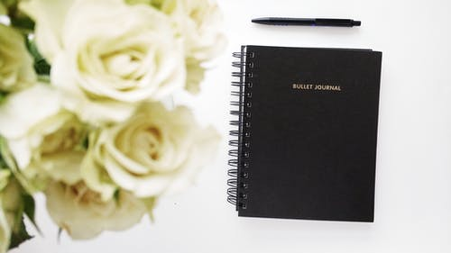
Where are you? (The 6 Positions of a Relationship)
In this video, you will discover:
The Six Position of Relationships
There are laws of love, rules, and skills which we can be learned and applied into your life.
There are 7 master skills of a relationship. Once you know them, practice them and make them habit. You will create a foundation which you can build phenomenal relationships from.

Slide 5
Where are you in your Relationship?
There are six Positions in the Relationship :
Position 1: A magnificent relationship with love and passion
Position 2: A relationship with love, but little or no passion.
Position 3: A relationship with not much love and not much passion.
Position 4: You are planning your escape.
Position 5: You are not in a relationship but want to be in one.
Position 6: You are not in a relationship and don’t want to be in one.

Slide 6
STAGE ONE: LOVE AND PASSION

Slide 7
STAGE TWO: NOT ENOUGH PASSION

Slide 8
STAGE THREE: A RELATIONSHIP OF CONVENIENCE

Slide 9
STAGE FOUR: PLANNING YOUR ESCAPE

Slide 10
STAGE FIVE: YOU ARE NOT IN A RELATIONSHIP BUT WANT TO BE IN ONE

Slide 11
STAGE SIX: YOU ARE NOT IN A RELATIONSHIP AND DON’T WANT TO BE IN ONE

Slide 12
Exercise for you
Which position are you really in right now? Why are you in that position?
Which stage are you committed to being in? What is it going to take to get you there?

Slide 13
Exercise for you
Which of the six relationship positions are you really in?
What has been preventing you from taking your relationship to the next level?
What beliefs, behaviour patterns, or emotions have held you back from taking the next step?
What would it take to change it all? What fears, beliefs, or past memories can you transform to go to the next level?
What do you need to do now to create the relationship you desire and deserve?

Slide 14
Why Relationships Fail
Relationship stress comes in many forms, but it doesn’t have to signal an ending.

Slide 15
The Four Rs: The Four Warning Signs in Relationships
Resistance
Resentment
Rejection
Repression.

Slide 16
Summary
Last notes on Relationships
The keys to solving all those situations are honesty and good communication.
If we run away from a relationship because we can’t face the truth, we’re going to face the same problem on the next one.
To maintain healthy relationships we must find time for ourselves

Slide 17
Summary
What is a relationship?
Why we need relationships
Where are you in the relationship?
Why relationships fail
The four R’s of ruined relationships

Slide 18
Reference

